Slide 1
LA 2028 Olympic games event program
Cindy Hallak, Kaila Fisher, Jonathan Gaudaire
Notes:
Hello everyone, we are going to present to you our findings regarding LA 2028 Olympic games event programming.

Slide 2
Table of contents
01
02
03
04
Problem statement
Data description
Procedures
Results
Notes:
So today, we will talk about what’s the objective of the project, the data we have available to conduct our analysis and how we obtained it, the actual analysis, and finally our recommendations.

Slide 3
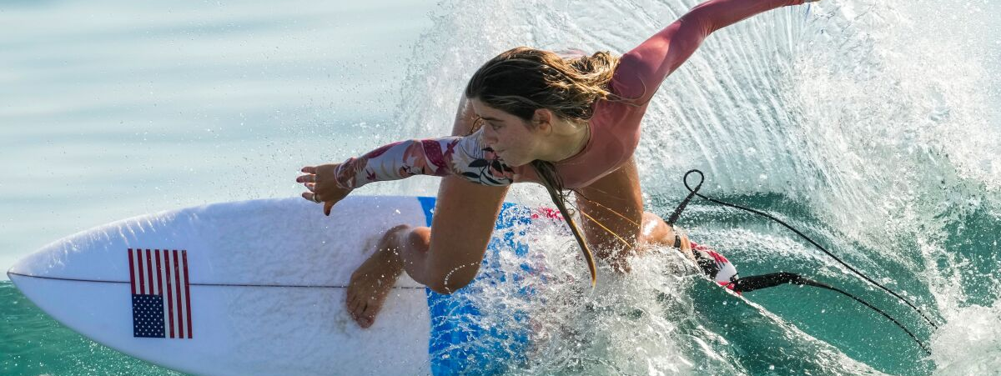
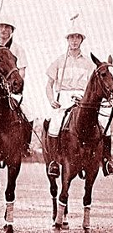
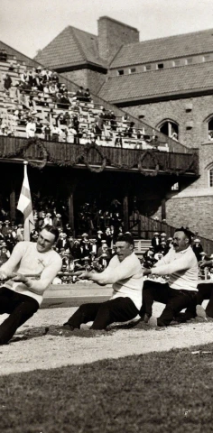
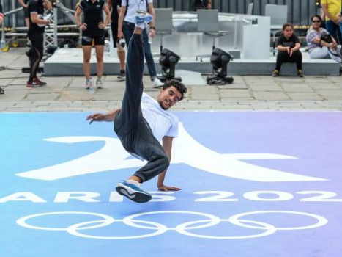
Notes:
So, I think you all know what the Olympic games are:
Held every four years in a different country every time, and at the end it’s always the US or China winning.
But did you notice that some sports are being included in the event, and some are being excluded from it?
For example, surfing was included in the Tokyo 2021 event for the first time, and breakdance will make its first appearance in 2024 in Paris. Other sports like polo or tug-of-war have been removed permanently from the event. Another example: baseball was scheduled in the 2021 event, but it will not be scheduled for the Paris 2024 event.

Slide 4
Criteria
Popularity at a global scale
Retain and reflect the Olympic traditions
Alignment with the host country popular sports
Notes:
The question you might ask yourselves now is: How do you decide which sports should be included and which should be excluded.
Well this decision is made by the international olympic committee. For the LA 2028 olympic games, they should announce their decision next year.
The three main criteria are:
-The popularity of the sport across the world
- The respect of the Olympic traditions like community, fairplay, simplicity
- The alignment with the host country’ popular sports: ex baseball.
We believe analyzing people’s attitude toward these sports regarding these criteria can help the IOC make the final decision.

Slide 5
Sports considered
Inclusion
Exclusion
Cricket
Baseball/Softball
Breakdance
Flag football
Karate
Kickboxing
Lacrosse
Motorsport
Squash
Boxing
Modern pentathlon
Skateboarding
Sport climbing
Surfing
Weightlifting
Notes:
So, these are the sports considered by the IOC.
There are 9 sports that presented their case to be included in the 2028 LA olympics, and 6 that are for now not included in the initial program (but it can still change)

Slide 6
Problem statement
Which of the 9 sports selected should be included in the LA 2028 event, and which ones should be excluded?
Notes:
So, which sports deserve to be included, and which deserve to be excluded.

Slide 7
Data collecting and cleaning process
Scrape data from Twitter with keywords
15 datasets: 9 “including” and 6 “excluding”
Variables: TweetID, Date, Text, Language, Username, Likes, Retweets
Host country bias
Notes:
To answer this question, we decided to scrape data from twitter, the only website where we could find information and text data about all the sports on the IOC shortlist. We used keyword matching to scrape data about each sport in the context of the olympics.
This provided us with a different dataset for each sport, with variables shown here.
We also decided to discriminate between tweets that were made before and after the Tokyo 2021 olympics happened for the sports to be excluded.Since these sports participated in the Tokyo Olympics, we were able to compare the attitude towards these sports before and after they were broadcasted, which is telling of how much people “enjoyed” watching them.
Finally, we only performed our analysis on tweets made in english. This creates a huge bias toward English-speakers opinion on the sports. However, we said earlier that one important criteria was the popularity of the sport in the host country. Therefore, we will assume in our analysis that the bias created by the data cleaning accounts for this criteria.

Slide 8
Analysis
Sentiment · Similarity · Engagement

Slide 9
Sentiment Analysis
Sports to Include
Sports to Exclude
Sport | Overall Sentiment Score
Kickboxing | 0.5371
Flag Football | 0.5159
Breakdance | 0.4179
Lacrosse | 0.3924
Baseball / Softball | 0.3610
Cricket | 0.3453
Motorsport | 0.3094
Karate | 0.2954
Squash | 0.2520
Sport | Overall Sentiment Score (Before Tokyo 2021) | Overall Sentiment Score (After Tokyo 2021)
Boxing | 0.3129 | 0.4081
Modern Pentathlon | 0.4131 | 0.1298
Skateboarding | 0.3184 | 0.3451
Sport Climbing | 0.4020 | 0.3732
Surfing | 0.3545 | 0.3996
Weightlifting | 0.3420 | 0.5568

Slide 10
Similarity Analysis
Respect for Olympics traditions - Attributes
Simple - Simplicity
Community
Subculture
Longevity

Slide 11
Similarity Analysis
Sports to Include
Sports to Exclude
Sport | Average Similarity
Breakdance | 0.089517846
Cricket | 0.069613035
Lacrosse | 0.068727986
Flag Football | 0.068588734
Baseball | 0.068509289
Karate | 0.066526864
Kickboxing | 0.064549722
Motorsport | 0.061561272
Squash | 0
Sport | Average Similarity
Skateboarding | 0.092471955
Weightlifting | 0.090154864
Boxing | 0.088321469
Surfing | 0.086758401
Sport Climbing | 0.077629978
Modern Pentathlon | 0

Slide 12
Engagement Analysis
Sports to Include
Sports to Exclude
Sport | Average Engagement per Post
Kickboxing | 61.68
Karate | 26.65
Baseball / Softball | 24.27
Motorsport | 21.88
Flag Football | 16.66
Lacrosse | 14.37
Cricket | 13.57
Breakdance | 9.55
Squash | 8.46
Sport | Average Engagement per Post
Sport Climbing | 14.07
Modern Pentathlon | 16.96
Surfing | 17.69
Boxing | 24.70
Skateboarding | 26.53
Weightlifting | 30.12

Slide 13
Results
Sports to Include: Ranking
Sports to Exclude: Ranking
Sport | Overall Average Score
Kickboxing | 0.9070
Flag Football | 0.6152
Breakdance | 0.5341
Baseball / Softball | 0.4815
Lacrosse | 0.4571
Karate | 0.4124
Cricket | 0.4003
Motorsport | 0.3804
Squash | 0
Sport | Overall Average Score
Modern Pentathlon | 0.0899
Sport Climbing | 0.4197
Surfing | 0.5819
Boxing | 0.8087
Skateboarding | 0.8881
Weightlifting | 0.9875

Slide 14
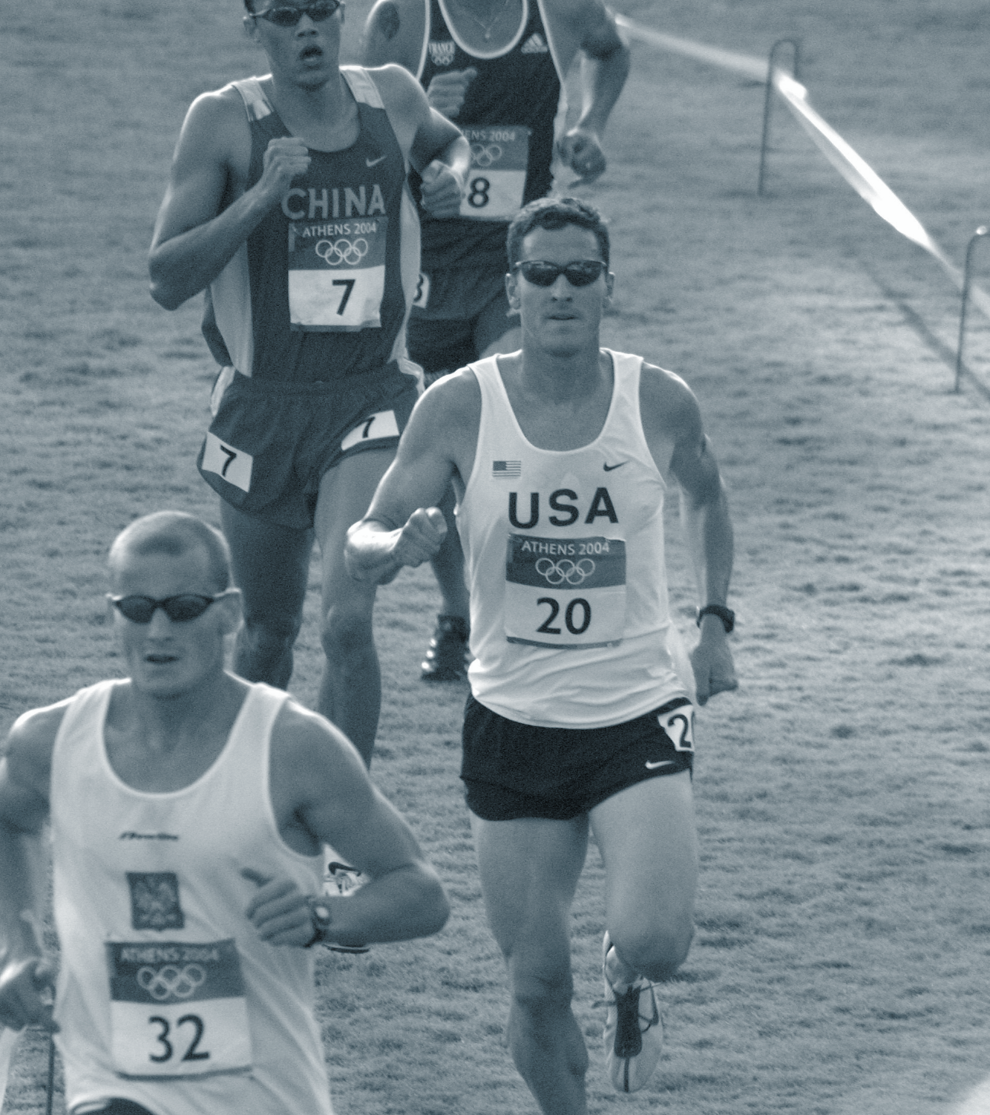
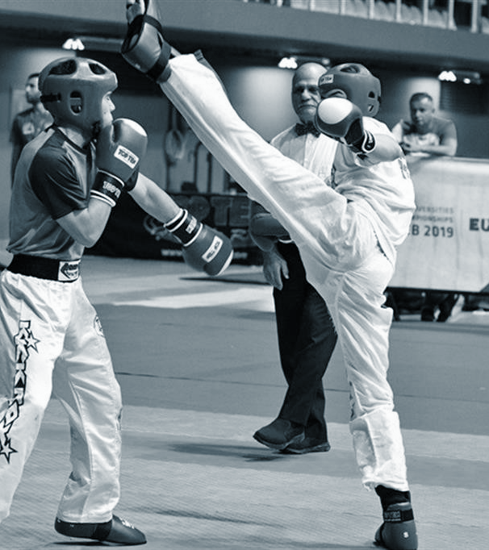
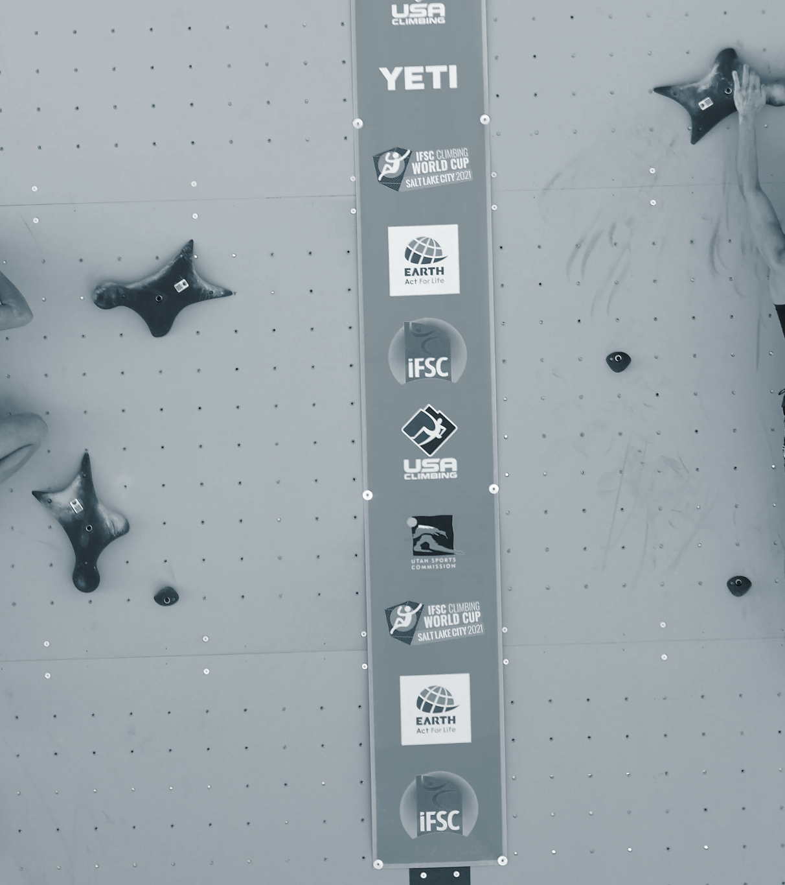
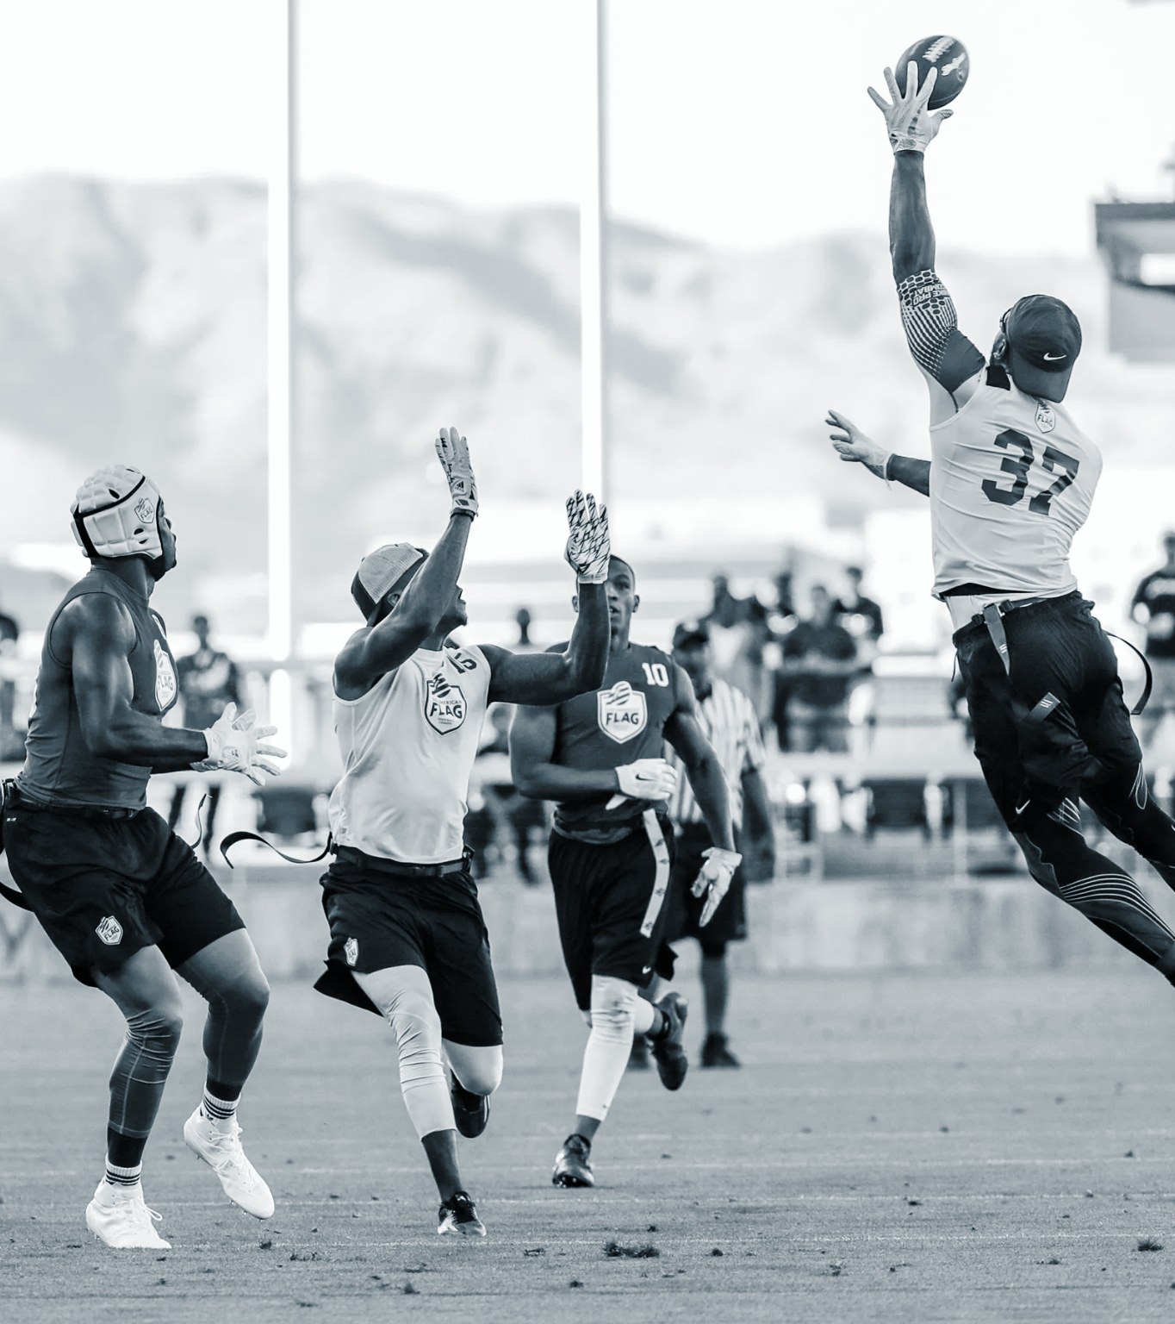
Recommendation
Notes:
To make our final recommendation we looked at the normalized scores. We decided to exclude 2 sports and include 2, as their scores significatively higher for the sports to include.
So, our first recommendation is to include kickboxing and exclude modern pentathlon. Indeed, the score was 0.9 for kickboxing, and 0.1 for modern pentathlon. The sentiment toward modern pentathlon also decreased before and after the Tokyo Olympics took place.
Our second recommendation is to include flag football and exclude sport climbing. The sentiment toward sport climbing also decreased after the 2021 event, and the score for flag football was higher. We also believe that including flag football respects the third criteria to meet, which is that the sports should be popular in the host country.

Slide 15
Thank you!

